Slide 1
Media AI
Notes:
Information in this document, including URL and other Internet Web site references, is subject to change without notice. Unless otherwise noted, the example companies, organizations, products, domain names, e-mail addresses, logos, people, places, and events depicted herein are fictitious, and no association with any real company, organization, product, domain name, e-mail address, logo, person, place or event is intended or should be inferred. Complying with all applicable copyright laws is the responsibility of the user. Without limiting the rights under copyright, no part of this document may be reproduced, stored in or introduced into a retrieval system, or transmitted in any form or by any means (electronic, mechanical, photocopying, recording, or otherwise), or for any purpose, without the express written permission of Microsoft Corporation.
Microsoft may have patents, patent applications, trademarks, copyrights, or other intellectual property rights covering subject matter in this document. Except as expressly provided in any written license agreement from Microsoft, the furnishing of this document does not give you any license to these patents, trademarks, copyrights, or other intellectual property.
The names of manufacturers, products, or URLs are provided for informational purposes only and Microsoft makes no representations and warranties, either expressed, implied, or statutory, regarding these manufacturers or the use of the products with any Microsoft technologies. The inclusion of a manufacturer or product does not imply endorsement of Microsoft of the manufacturer or product. Links may be provided to third party sites. Such sites are not under the control of Microsoft and Microsoft is not responsible for the contents of any linked site or any link contained in a linked site, or any changes or updates to such sites. Microsoft is not responsible for webcasting or any other form of transmission received from any linked site. Microsoft is providing these links to you only as a convenience, and the inclusion of any link does not imply endorsement of Microsoft of the site or the products contained therein.
© 2018 Microsoft Corporation. All rights reserved. Microsoft and the trademarks listed at https://www.microsoft.com/en-us/legal/intellectualproperty/Trademarks/Usage/General.aspx are trademarks of the Microsoft group of companies. All other trademarks are property of their respective owners.

Slide 2
Abstract and learning objectives
Abstract
In this workshop, students will learn how to build, setup, and configure a Web Application that performs media streaming using Azure Services; including the Video Indexer API. Students will also learn how to implement video processing using Logic Apps, Azure Functions, and Video Indexer API to encode and transcribe videos.
Learning objectives
Setup Video Indexer API
Upload videos to Blob Storage to be encoded with Azure Video Indexer
Integrate Video Indexer through Logic Apps and Azure Functions

Slide 3
Step 1: Review the customer case study
Outcome
Analyze your customer needs
Timeframe
15 minutes

Slide 4
Customer situation
Contoso Consulting is a mature consulting firm that has been in the IT Consulting business for over 30 years with clients all over the world. They have a history of mainly specializing in Microsoft technologies, but do have an established practice of offering Linux and OSS based consulting. The company has adapted to the ever-changing landscape of IT for a long time, and has been involved in the training and adoption / transition process of many of its clients over the years. In addition to IT Consulting services, Contoso provides on-site and video-based training to their larger clients. This involves creating custom training content and course agendas based on the client’s needs and project being delivered.

Slide 5
Customer situation
Clients have always gotten a lot of value out of Contoso Consulting’s training classes. Even though Contoso has trained the clients development and/or engineering teams, they are still brought back for future work since they have been able to deliver such great value over the years. Over the last couple years, clients have been asking them for more and more training courses. The referrals for training have been trickling down and coming from many of Contoso’s smaller clients in addition to their larger clients. They have had to turn away a lot of smaller training contract opportunities due to the inability to create solutions affordable enough for their smaller clients.

Slide 6
Customer situation
Due to the efforts of their sales teams, Contoso has created many video-based training classes they have been able to deliver to clients using DVD’s or MP4 files. While this enables them to reuse training content and deliver it in a more affordable and scalable manner, it just does not give them the full capabilities they would like. As the content ages, the DVD’s or MP4’s are no longer relevant, and clients are solely purchasing individual courses. They have also used some of the available video hosting services on the market with only limited success. Everything they have tried so far has not quite offered the features and capabilities that an Enterprise needs for a good quality video streaming experience.

Slide 7
Customer situation
Because of this changing landscape of getting further into the IT Training business, the CEO of Contoso Consulting, Jill Sampson, has decided to pursue the development of Contoso’s own online, on-demand, video training service. Jill says, “I want to build the Netflix of IT Training!”. This new service will allow Contoso to easily resell subscriptions to their clients for all their video training courses. This will include general courses that any client can be sold, to one-off custom courses built for specific clients based on their own specific IT Infrastructure or Custom Software that Contoso has delivered to them.

Slide 8
Customer situation
Mary Bowman, the Director of IT Operations for Contoso, has seen some demos of the media and video services within the Microsoft Azure platform. However, she still has several questions to answer before making a final decision on the technology and platforms to use for implementation. The Contoso IT Development and Engineering teams do not have much experience with building and maintaining video streaming services, so they are a bit uncertain of what path to take with the design and architecture at this point. In initial conversations with the sales team, Mary has said, “We have a tremendous amount of Enterprise IT experience within our organization, we just need a little help figuring out the unknowns here.”

Slide 9
Customer needs
The system must scale globally for their many clients all over the world, including new clients as Contoso grows their IT Training business
They need to lessen the burden of content development by automatically generating video transcripts (video captions) and translate those into many other languages as well
Copy protection or DRM are desired to keep their IP from getting stolen.
The ability to easily search through the content is needed so the service can be an easy to use lookup reference
The system needs to have an Administration Portal where new and updated content can be maintained by their internal staff
Use serverless compute where possible to minimize overall maintenance and overhead cost

Slide 10
Customer objections
Is there a service to automate transcription of the videos? Manual transcription is costly.
There are plenty of video encoding tools out there, but what does Azure offer to do this more easily?
Do we need to hire translators to translate the transcripts into other languages?
When we grow our library of content, how are we going to ensure the search capabilities stay responsive?

Slide 11
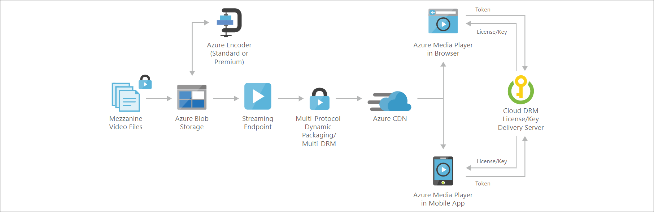
Common scenarios Video-on-demand digital media
Notes:
https://azure.microsoft.com/en-us/solutions/architecture/digital-media-video/

Slide 12
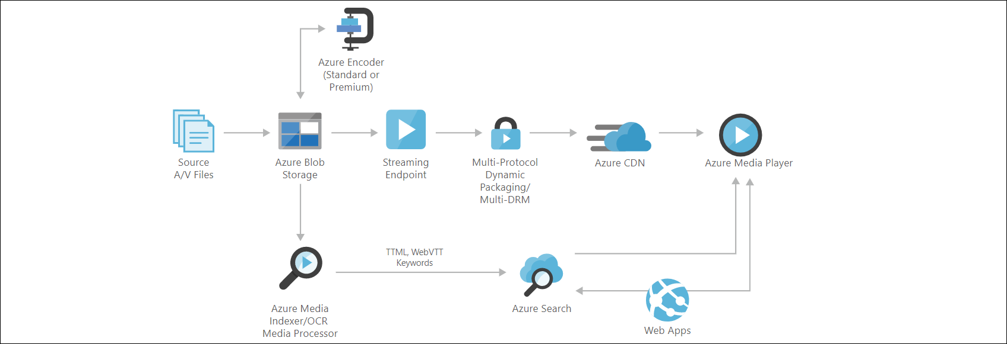
Common scenarios Keyword search/speech-to-text/OCR digital media
Notes:
https://azure.microsoft.com/en-us/solutions/architecture/digital-media-speech-text/

Slide 13
Step 2: Design the solution
Outcome
Design a solution and prepare to present the solution to the target customer audience in a 15-minute chalk-talk format.
Timeframe
60 minutes
Business needs (10 minutes) | Respond to questions outlined in your guide and list the answers on a flipchart.
Design (35 minutes) | Design a solution for as many of the stated requirements as time allows. Show the solution on a flipchart.
Prepare (15 minutes) | Identify any customer needs that are not addressed with the proposed solution. Identify the benefits of your solution. Determine how you will respond to the customer’s objections. Prepare for a 15-minute presentation to the customer.

Slide 14
Step 3: Present the solution
Outcome
Present a solution to the target customer in a 15-minute chalk-talk format.
Timeframe
30 minutes (15 minutes for each team to present and receive feedback)
Directions
Pair with another table
One table is the Microsoft team and the other table is the customer
The Microsoft team presents their proposed solution to the customer
The customer asks one of the objections from the list of objections in the case study
The Microsoft team responds to the objection
The customer team gives feedback to the Microsoft team

Slide 15
Wrap-up
Outcome
Identify the preferred solution for the case study
Identify solutions designed by other teams
Timeframe
15 minutes

Slide 16
Preferred target audience
Jill Sampson, Chief Executive Officer
Mary Bowman, Director of IT Operations

Slide 17
Preferred solution
The preferred solution consists of the following high-level components:
Admin website through which videos can be uploaded by Contoso employees
“Public” / End-user website through which customers of Contoso can watch video courses, including access to Video Insights such as transcriptions, captions, and search features
Background processing that is implemented with a serverless architecture using Azure Logic Apps and Azure Functions. This background processing orchestrates the video upload / encoding workflow.
Azure Video Indexer service / API provides Video Encoding and Indexing capabilities, as well as video streaming to the “Public” / End-user website
Backend database is used to store application data. It is recommended to use Azure Cosmos DB for higher scalability, but Azure SQL Database could also be implemented

Slide 18
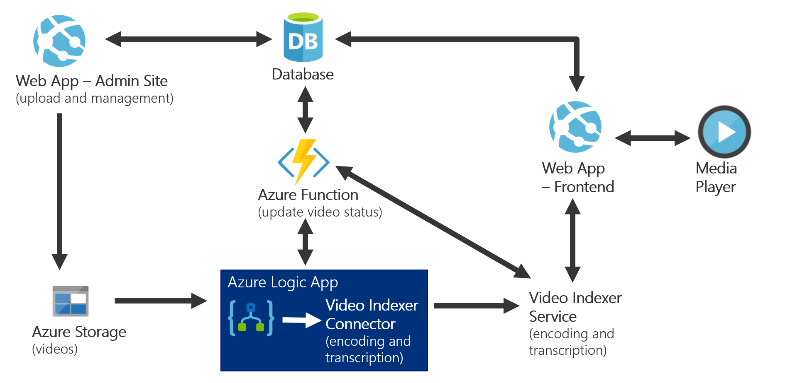
Preferred solution

Slide 19
Preferred solution
Admin and “Public” / End-user website
Hosted using Azure Web Apps
Separate App Service Plan for each app so they can be scaled independently
Admin website secures using Azure AD so only Contoso employees can access it

Slide 20
Preferred solution
Video Encoding and Transcription
Use Azure Video Indexer API
Provides Video Encoding
Provides Video Transcription (Audio and OCR) – including automatic translation into many different languages (English, Chinese, German, etc.)

Slide 21
Preferred solution
Background Processing
Video files uploaded to Azure Storage Account
Azure Logic App triggered to upload videos to Video Indexer service
Azure Function integrated with Logic App to update Video processing status in back-end database

Slide 22
Preferred objections handling
Is there a service to automate transcription of the videos? Manual transcription is costly. Potential Answer:
Microsoft has gone through a couple generations of transcription services and APIs over the years. The most recent and most accurate transcription functionality is contained within the Video Indexer service that is part of Cognitive Services. Video Indexer can easily generate transcripts for both audio and video.

Slide 23
Preferred objections handling
There are plenty of video encoding tools out there, but what does Azure offer to do this more easily? Potential Answer:
The Video Indexer that is part of Cognitive Services provides a PaaS service that enables customers with digital and audio content to automatically extract metadata and use it to build intelligent innovative applications.
Azure Media Services does offer video encoding and delivery as a PaaS service, but it is pretty “bare-bones” in its functionality.

Slide 24
Preferred objections handling
Do we need to hire translators to translate the transcripts into other languages?
Potential Answer:
The traditional path would be to hire translators to accurately translate content to different languages. The Video Indexer service, in addition to its Transcription and other cognitive capabilities, can translate the transcriptions into many different supported languages without any effort on your part.

Slide 25
Preferred objections handling
When we grow our library of content, how are we going to ensure the search capabilities stay responsive?
Potential Answer:
The Video Indexer service does provide text search APIs that can be used to implement search capabilities. If a different search service is necessary, it is possible to feed video transcripts into another search service or database.

Slide 26
Customer quote
“Your expertise, along with the proposed solution architecture, really fills in the gaps to help us build the on-demand video training service that will help our company grow to new heights!”
- Mary Bowman, Director of IT Operations

